Slide 1
Chapter 3
3.4: Rectangle Collisions

Slide 2
Collision between a Rectangle and a Circle
Step A: Compute the nearest edge
Between circle center and the rectangle

Slide 3
Collision between a Rectangle and a Circle
Step A: Compute the nearest edge
Between circle center and the rectangle
Step B: if outside: determine circle center
Region R1

Slide 4
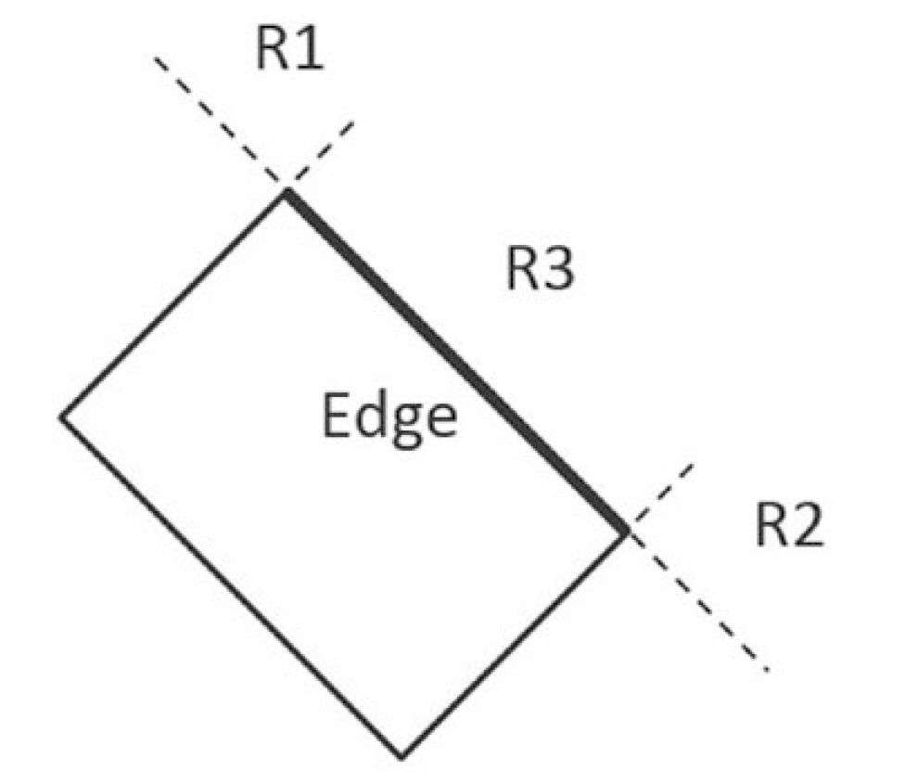
Collision between a Rectangle and a Circle
Step A: Compute the nearest edge
Between circle center and the rectangle
Step B: if outside: determine circle center in
Region R1
Region R2
Region R3
If center inside: collide!

Slide 5
Collision between a Rectangle and a Circle
Step A: Compute the nearest edge
Between circle center and the rectangle
Step B: if outside: determine circle center in
Region R1
Region R2
Region R3
If center inside: collide!

Slide 6
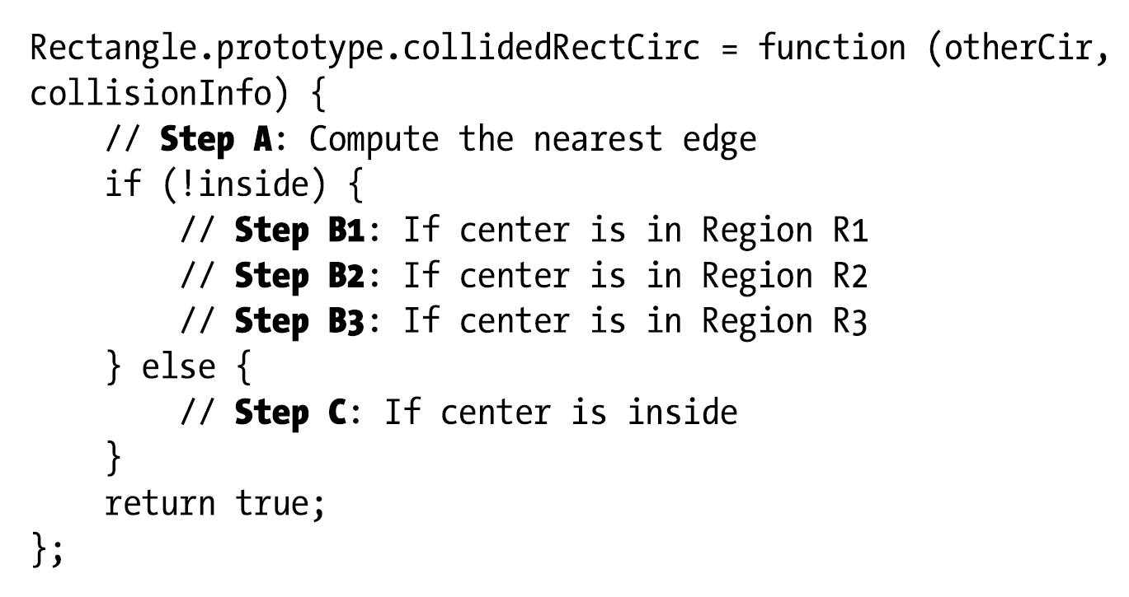
Implementation

Slide 7
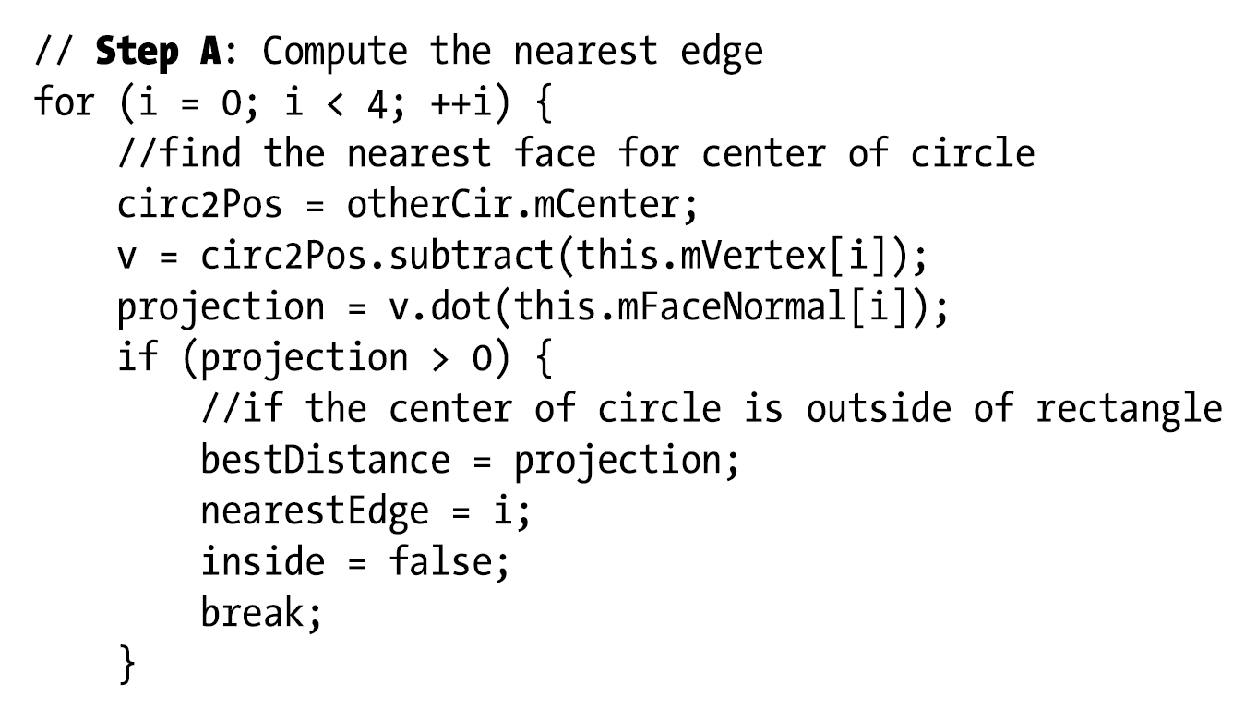
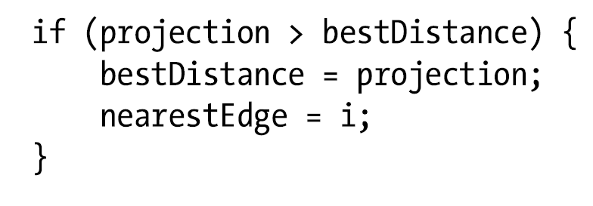
Step A: closest edge
mFaceNormal[i]
projection
v

Slide 8
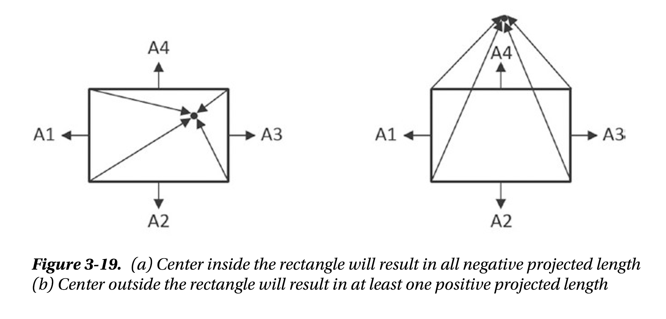
Step B:

Slide 9
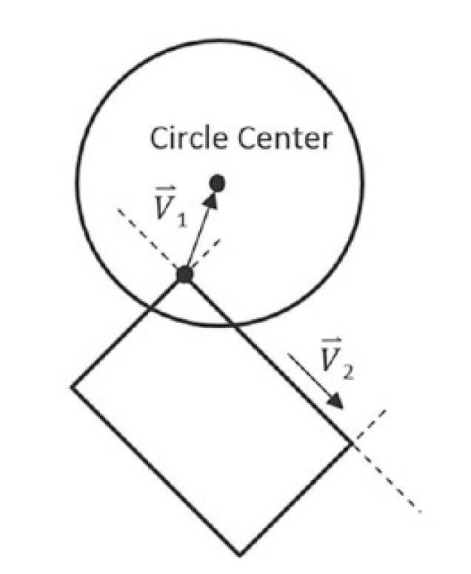
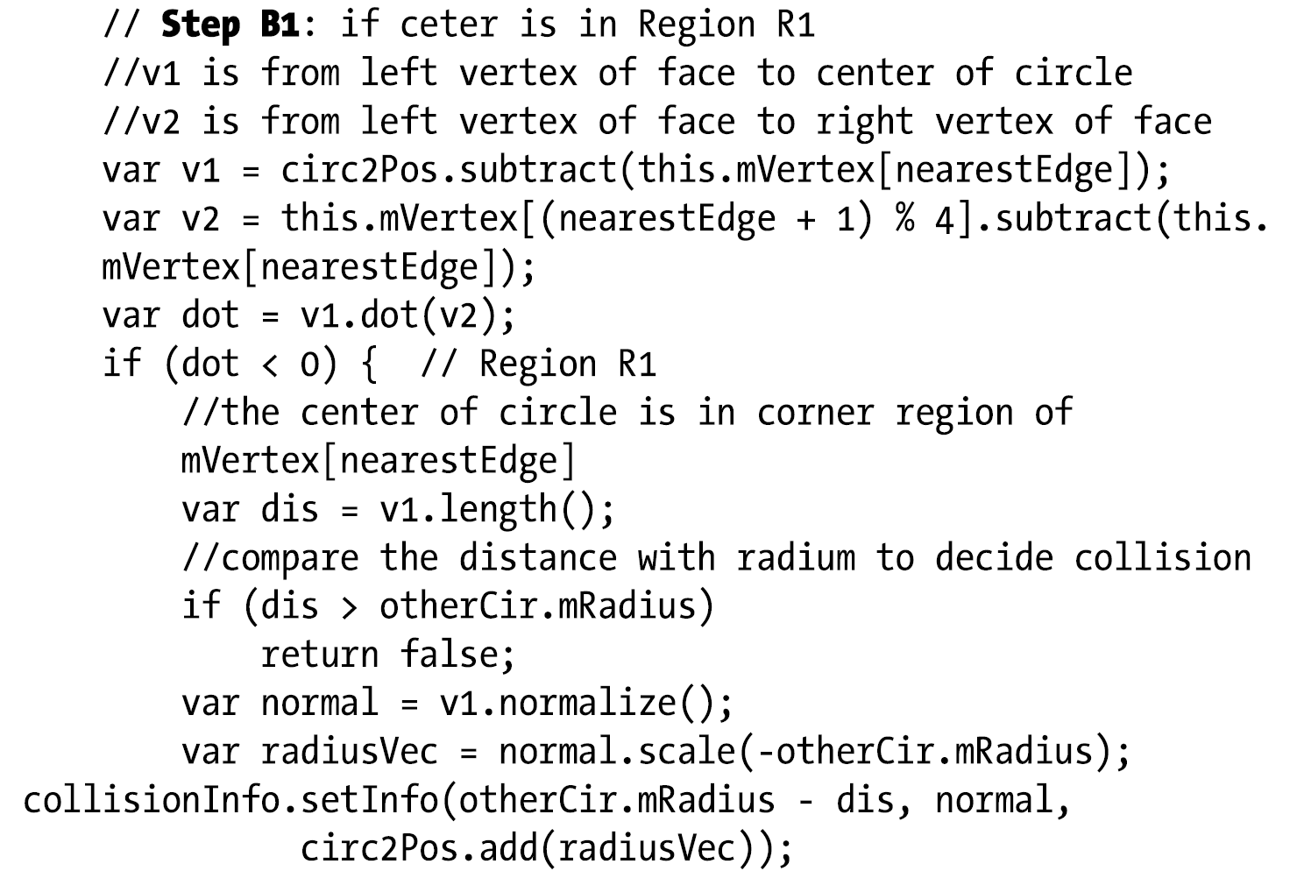
Step B1

Slide 10
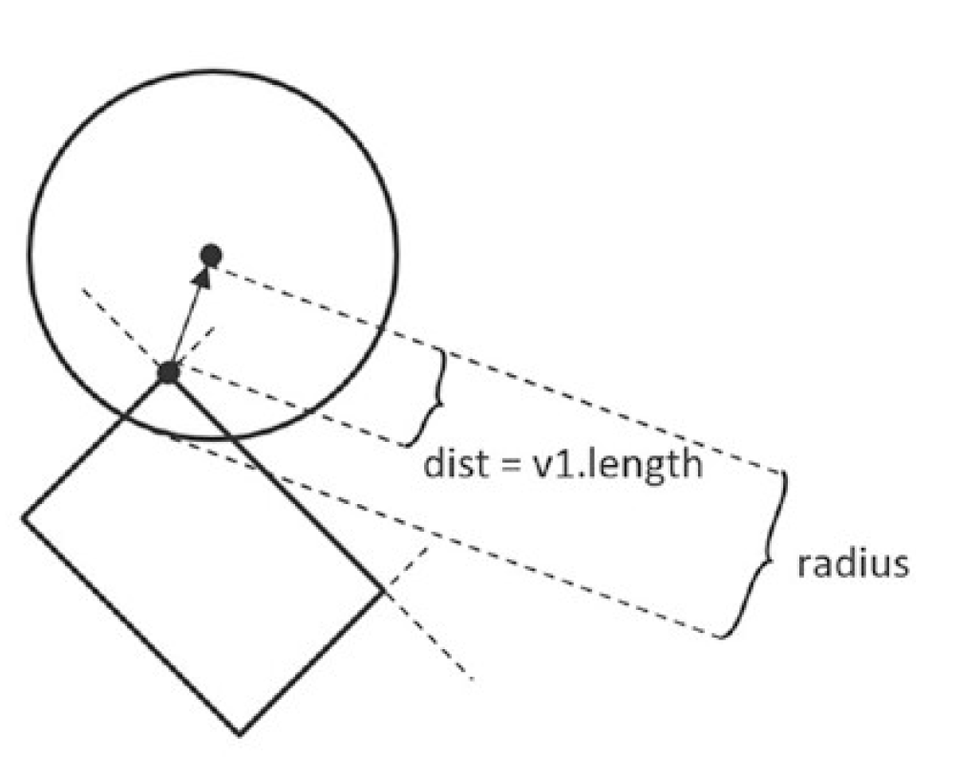
Step B1

Slide 11
Step B1
Label these on the diagram!

Slide 12
Step B1 VERY Similar to B2
radiusVec
circ2Pos
Radius - dist
circ2Pos + radiusVec

Slide 13
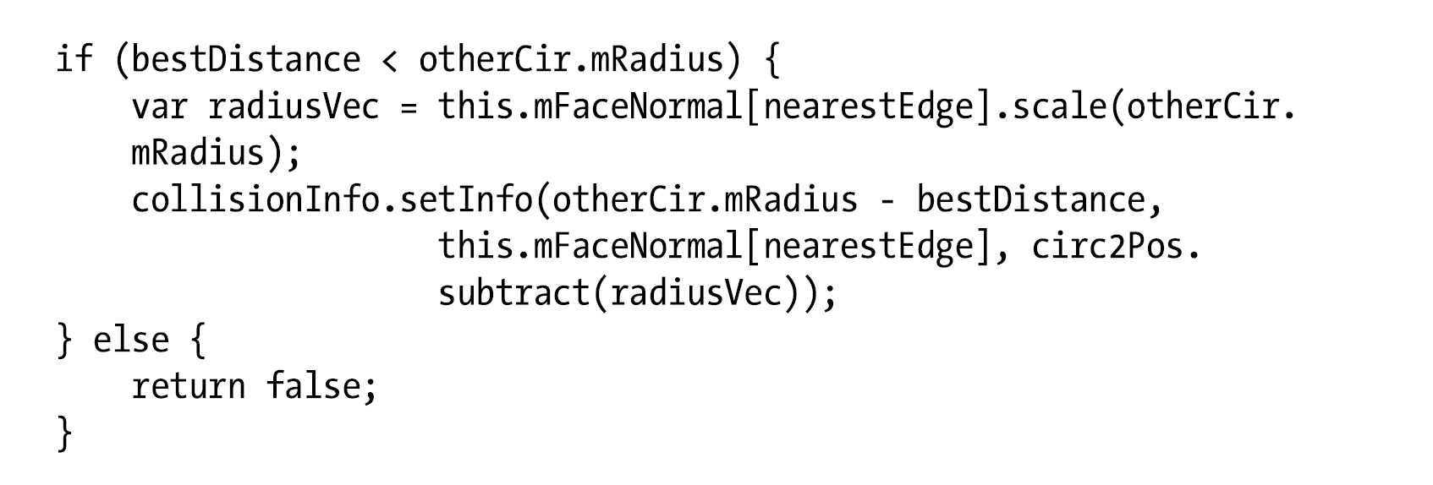
Step B3:

Slide 14
Step B3:
Label these on the diagram!

Slide 15
Step B3:
Label these on the diagram!
mFaceNormal
radiusVec
circ2Pos
bestDistance
circ2Pos - radiusVec
mRadius - bestDistance

Slide 16
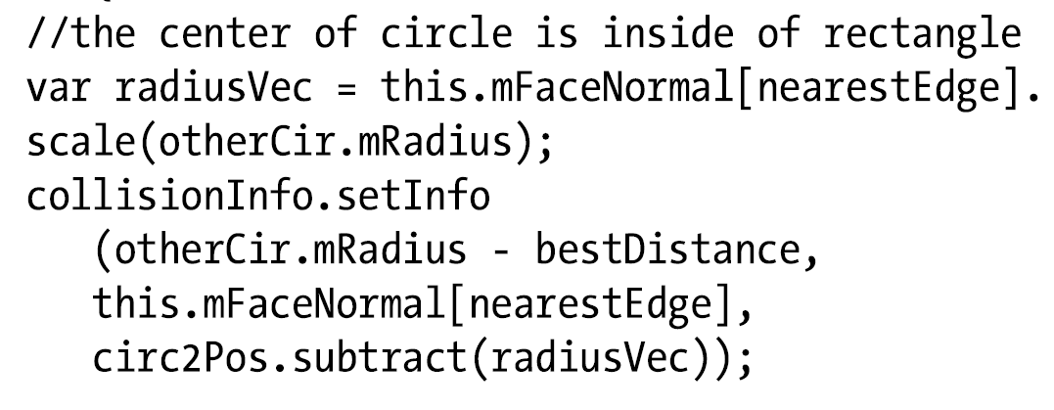
If Inside

Slide 17
If Inside
mFaceNormal
radiusVec
circ2Pos
bestDistance (is –ve)!
circ2Pos - radiusVec
mRadius - bestDistance

